Slide 1

API
Sudarshan

Slide 2
TOPIC
What is API
OS API
WEB API
SOAP
API OPTIONS
POSTMAN TOOL

Slide 3
API
URL
Query Parameter
Path Parameter

Slide 4
GET
POST
PUT
DELETE
TRACE
OPTIONS
HEAD
CONNECT

Slide 5
Response
2XX – 200, 201
3XX - 301
4XX -400, 401, 403
5XX -500

Slide 6
POSTMAN
Collection
Request
ENDPOINT
ENVIRONMENT
PARAMS
Authorization
Headers
Body
Prerequest Script
Tests
Cookies

Slide 7
JSON
“JSON” stands for “JavaScript Object Notation
{"skillz": { "web":[ { "name": "html", "years": 5 }, { "name": "css", "years": 3 }] "database":[ { "name": "sql", "years": 7 }] }}

Slide 8
An object is an unordered set of name/value pairs
A value can be: A string, a number, true, false, null, an object, or an array
String in double quotes

Slide 9
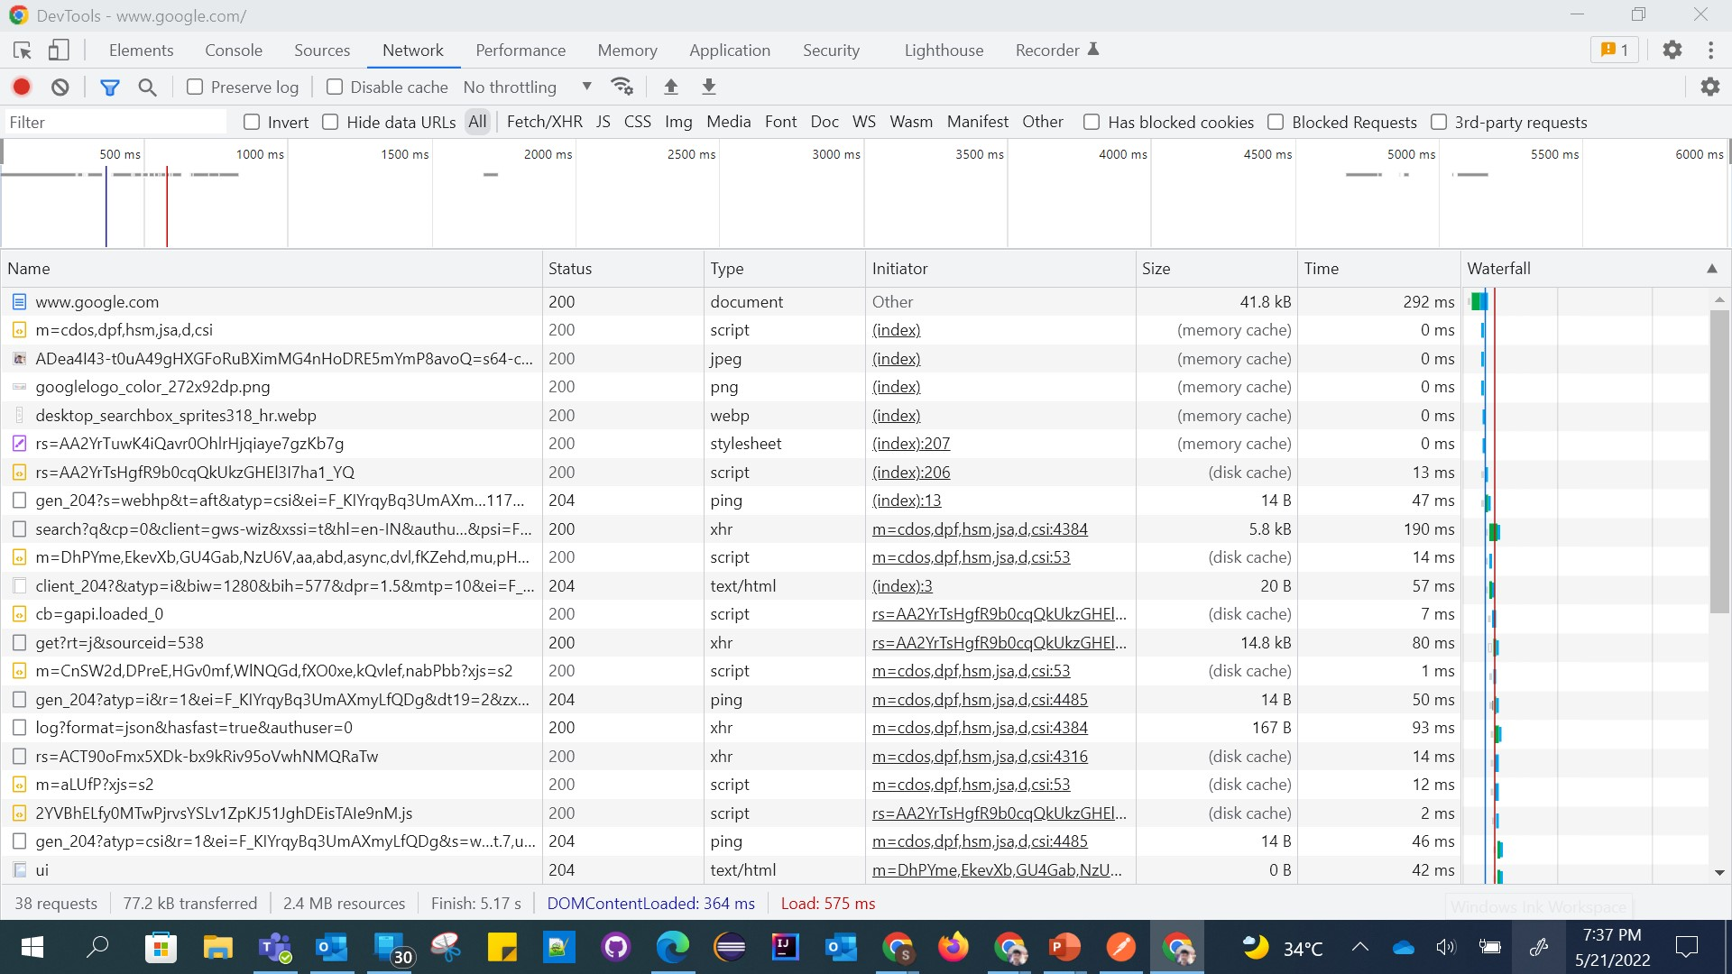

Slide 10

